Slide 1
AIRLINE PASSENGER SATISFACTION ANALYSIS
BY
TUSHAR KSHIRSAGAR
M.Sc.(Statistics)

Slide 2
CUSTOMER TYPE DISTRIBUTION
First-time
18%
Returning
82%
18% of passengers are first-time travelers.
82% are returning customers, highlighting a strong trend of customer loyalty and a major target segment for retention strategies.

Slide 3
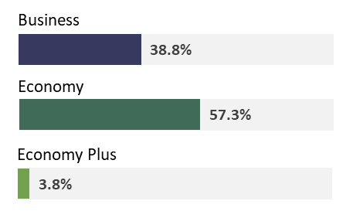
CLASS PREFERENCE OF FIRST-TIME TRAVELERS
Business Class: 38.8%
Economy Class: 57.3%
Economy Plus: 3.8%
Insight: Economy class dominates for first-time travelers, but Business Class holds a significant share.

Slide 4
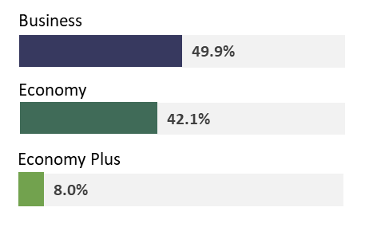
CLASS PREFERENCE OF RETURNING TRAVELERS
Business Class: 49.9%
Economy Class: 42.1%
Economy Plus: 8.0%
Insight: Returning customers prefer Business Class, suggesting a higher likelihood of premium service loyalty.

Slide 5
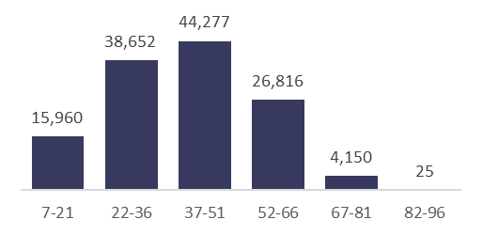
TRAVELER DISTRIBUTION BY AGE GROUPS (VOLUME)
Insight: Travel frequency peaks for the 37-51 age group and declines with older age.

Slide 6
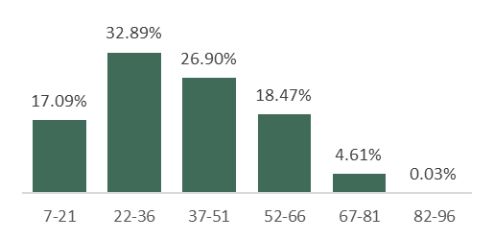
TRAVELER DISTRIBUTION BY AGE GROUPS (PERCENTAGE)
Insight: The highest percentage of travelers falls within the 22-51 age bracket.

Slide 7
GENDER AND TRAVEL PURPOSE BREAKDOWN
First-time
Returning
Male
Personal
102
19,980
Business
10,835
33,064
Female
Personal
99
20,006
Business
12,744
33,050
Male Travelers:
Personal: First-time = 102, Returning = 19,980
Business: First-time = 10,835, Returning = 33,064
Female Travelers:
Personal: First-time = 99, Returning = 20,006
Business: First-time = 12,744, Returning = 33,050
Key Insight: Male and Female passengers show similar travel patterns with a strong dominance in the business category.

Slide 8

CUSTOMER SATISFACTION
56.6% of customers are Neutral or Dissatisfied.
43.4% of customers are Satisfied.

Slide 9
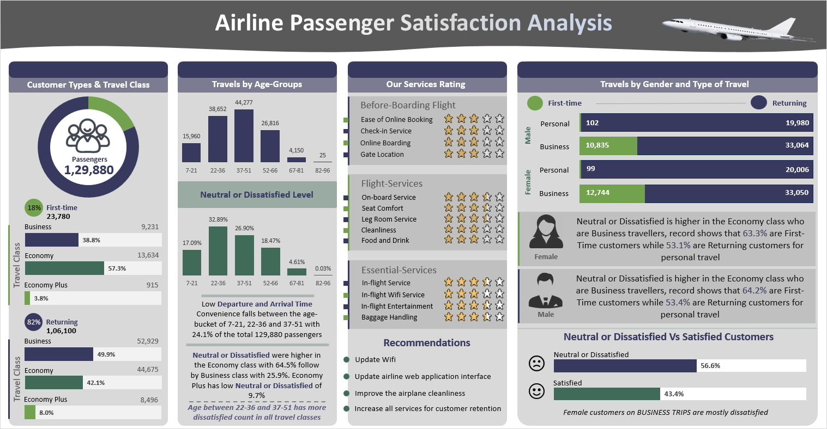

Slide 10
THANK YOU!

